Slide 1
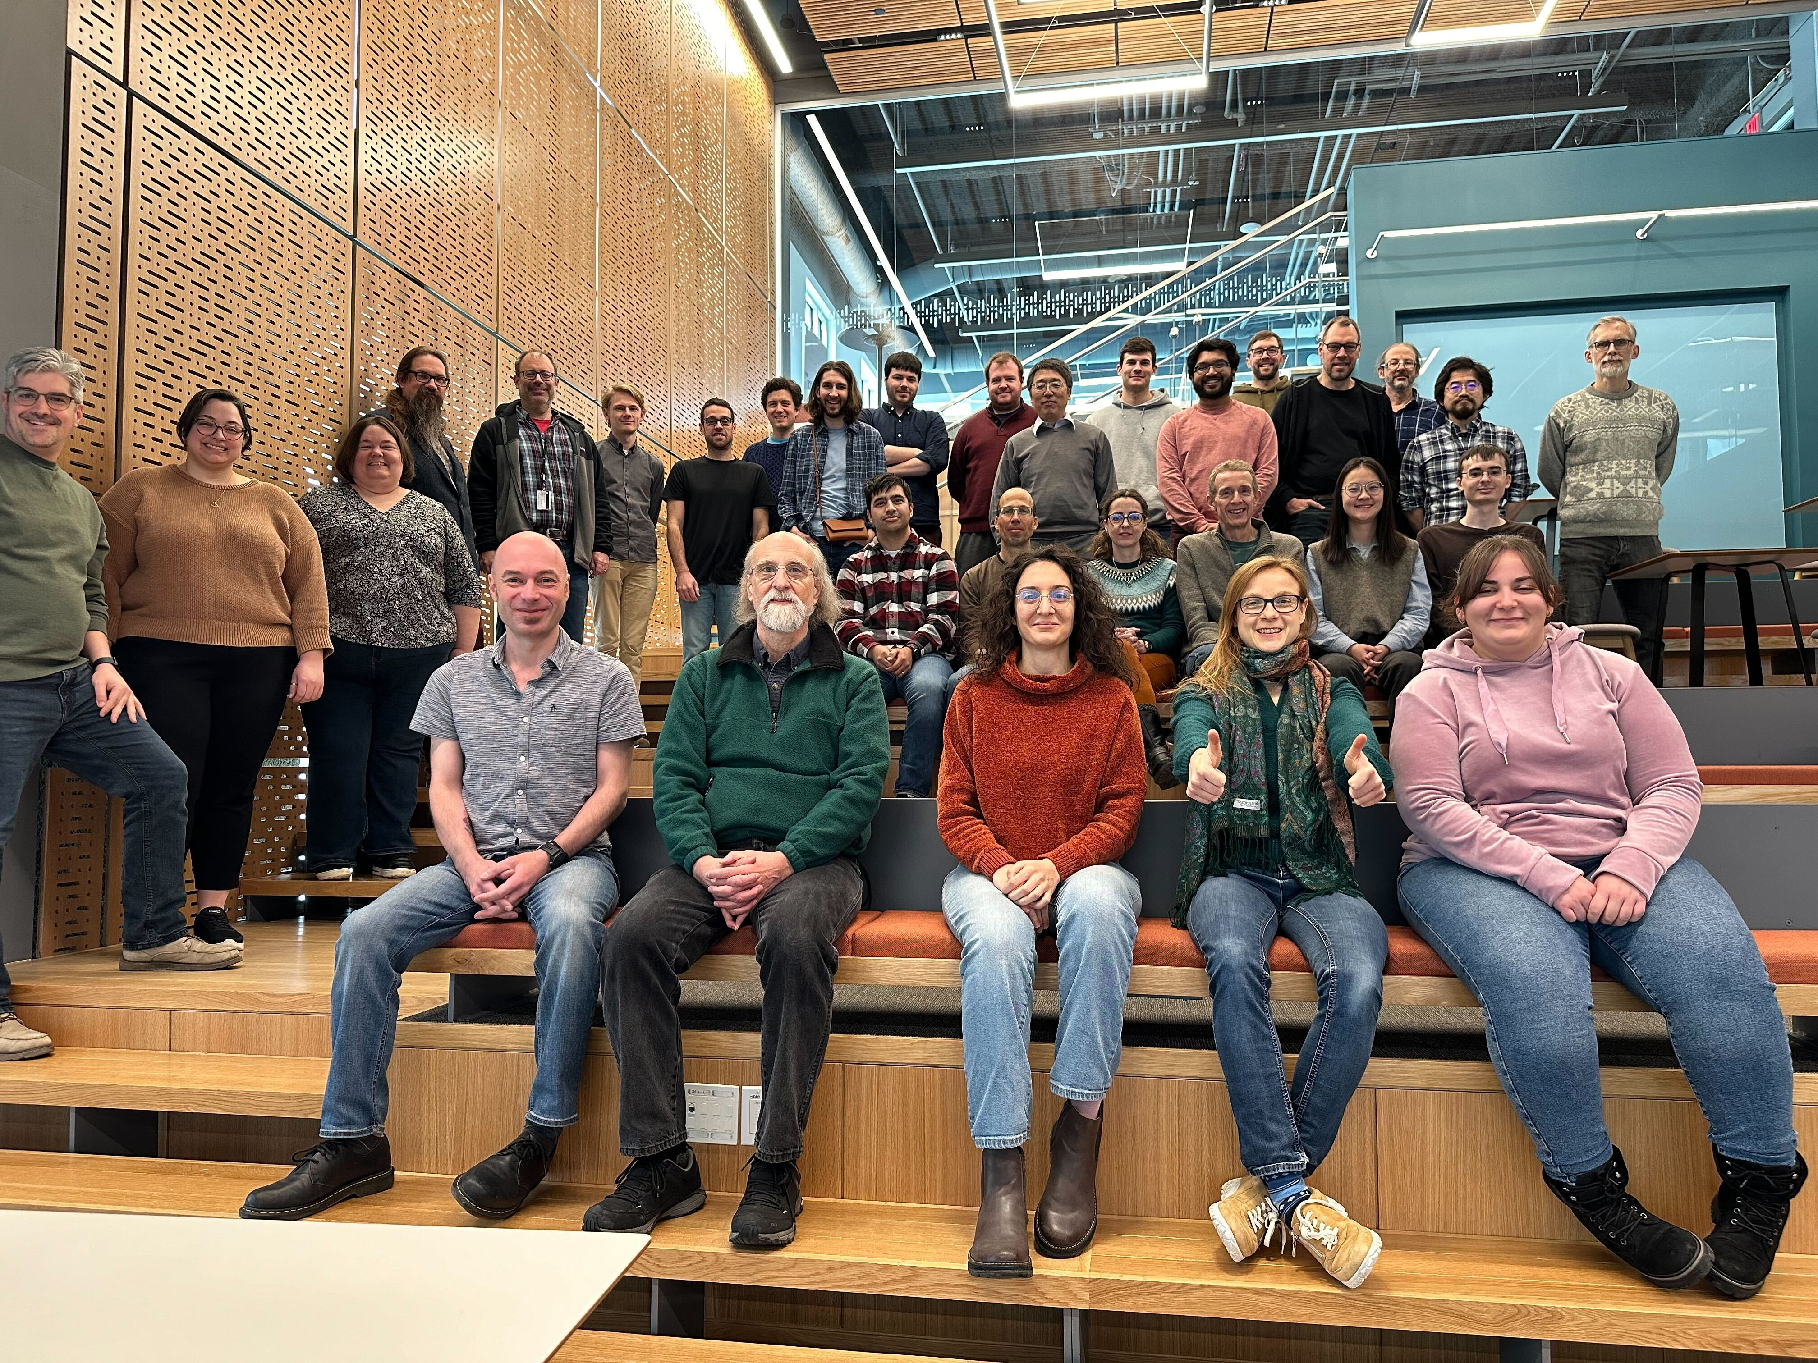
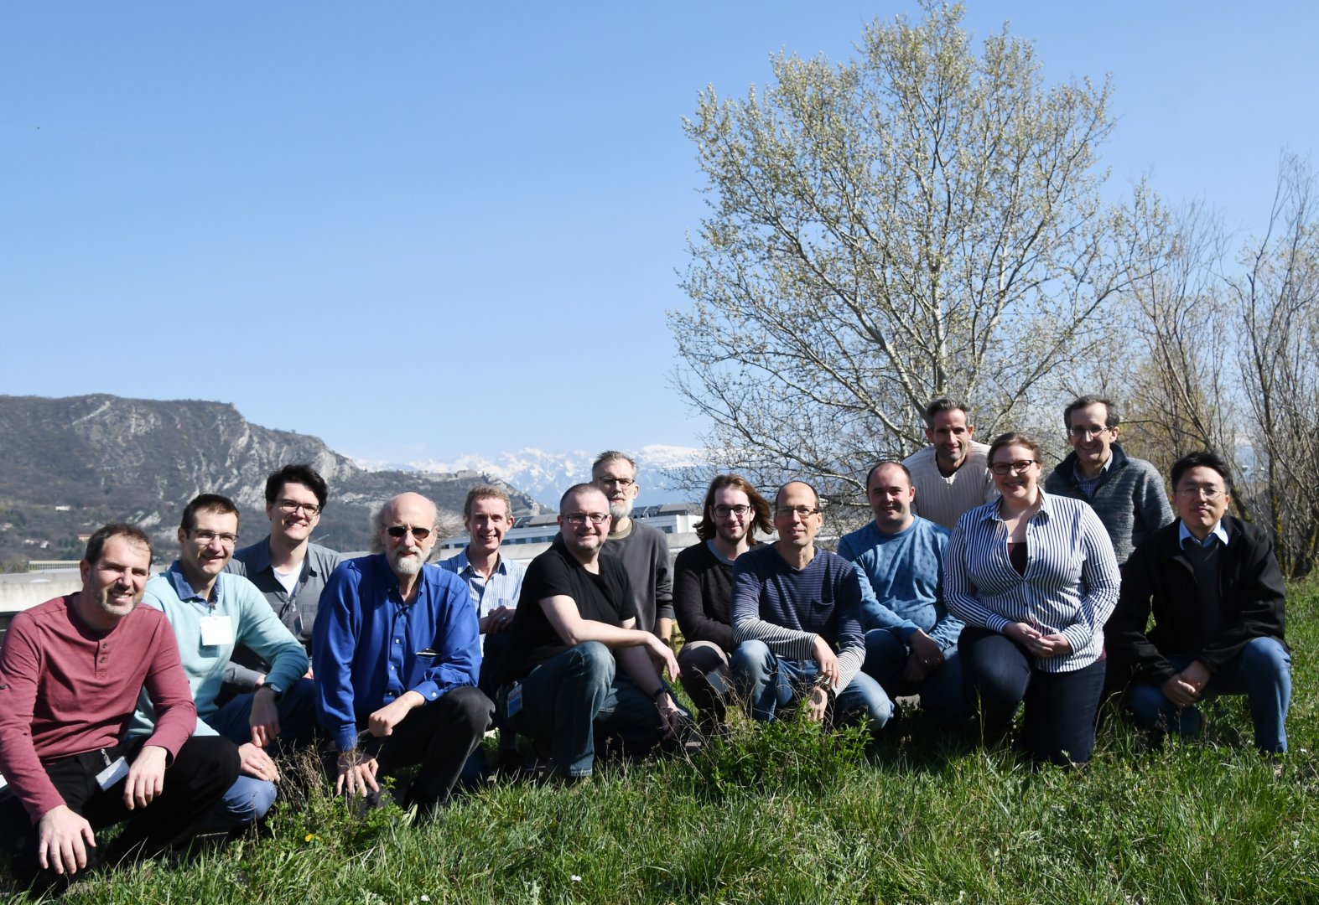
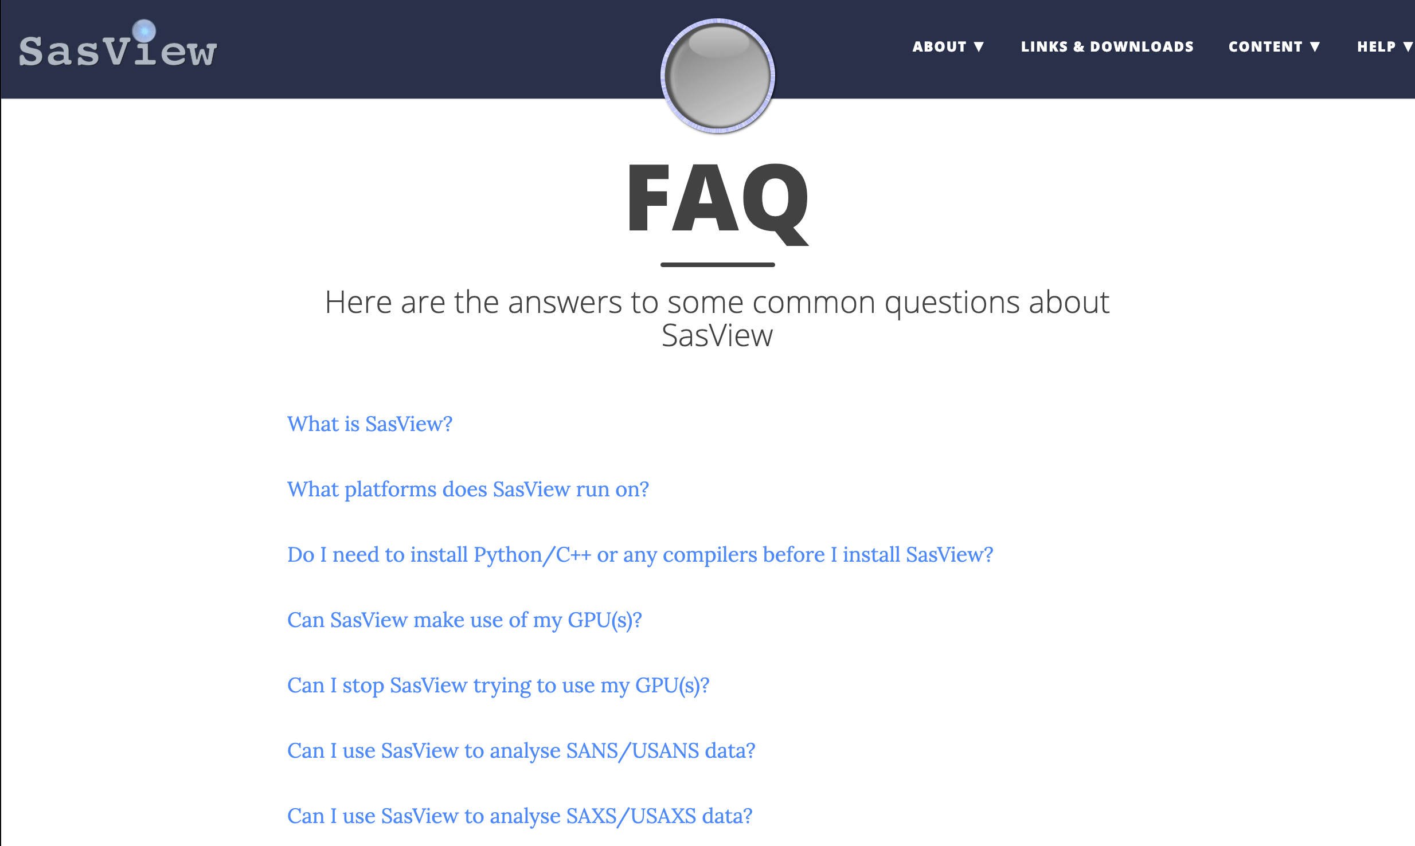
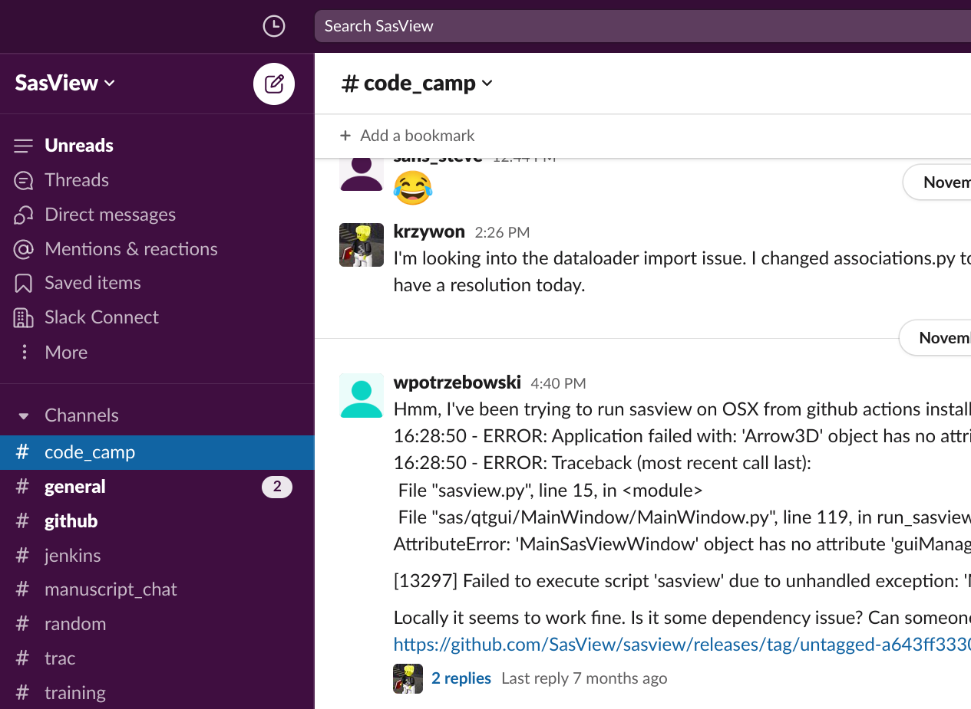
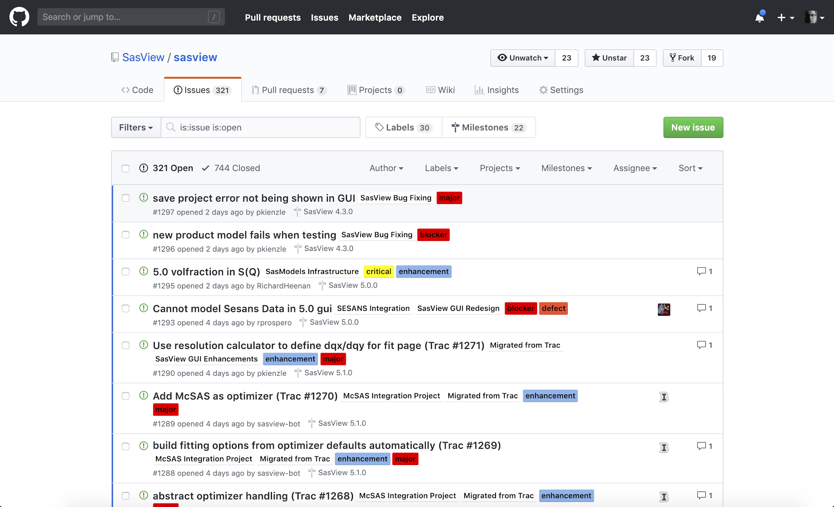
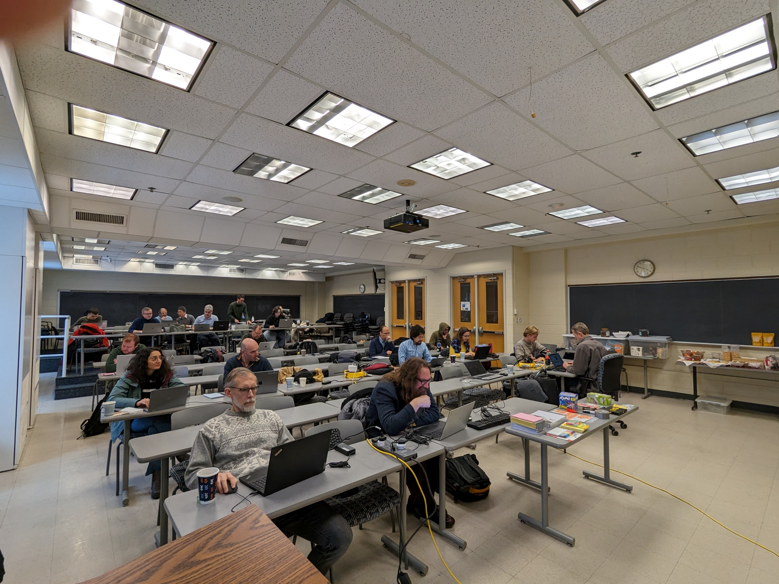
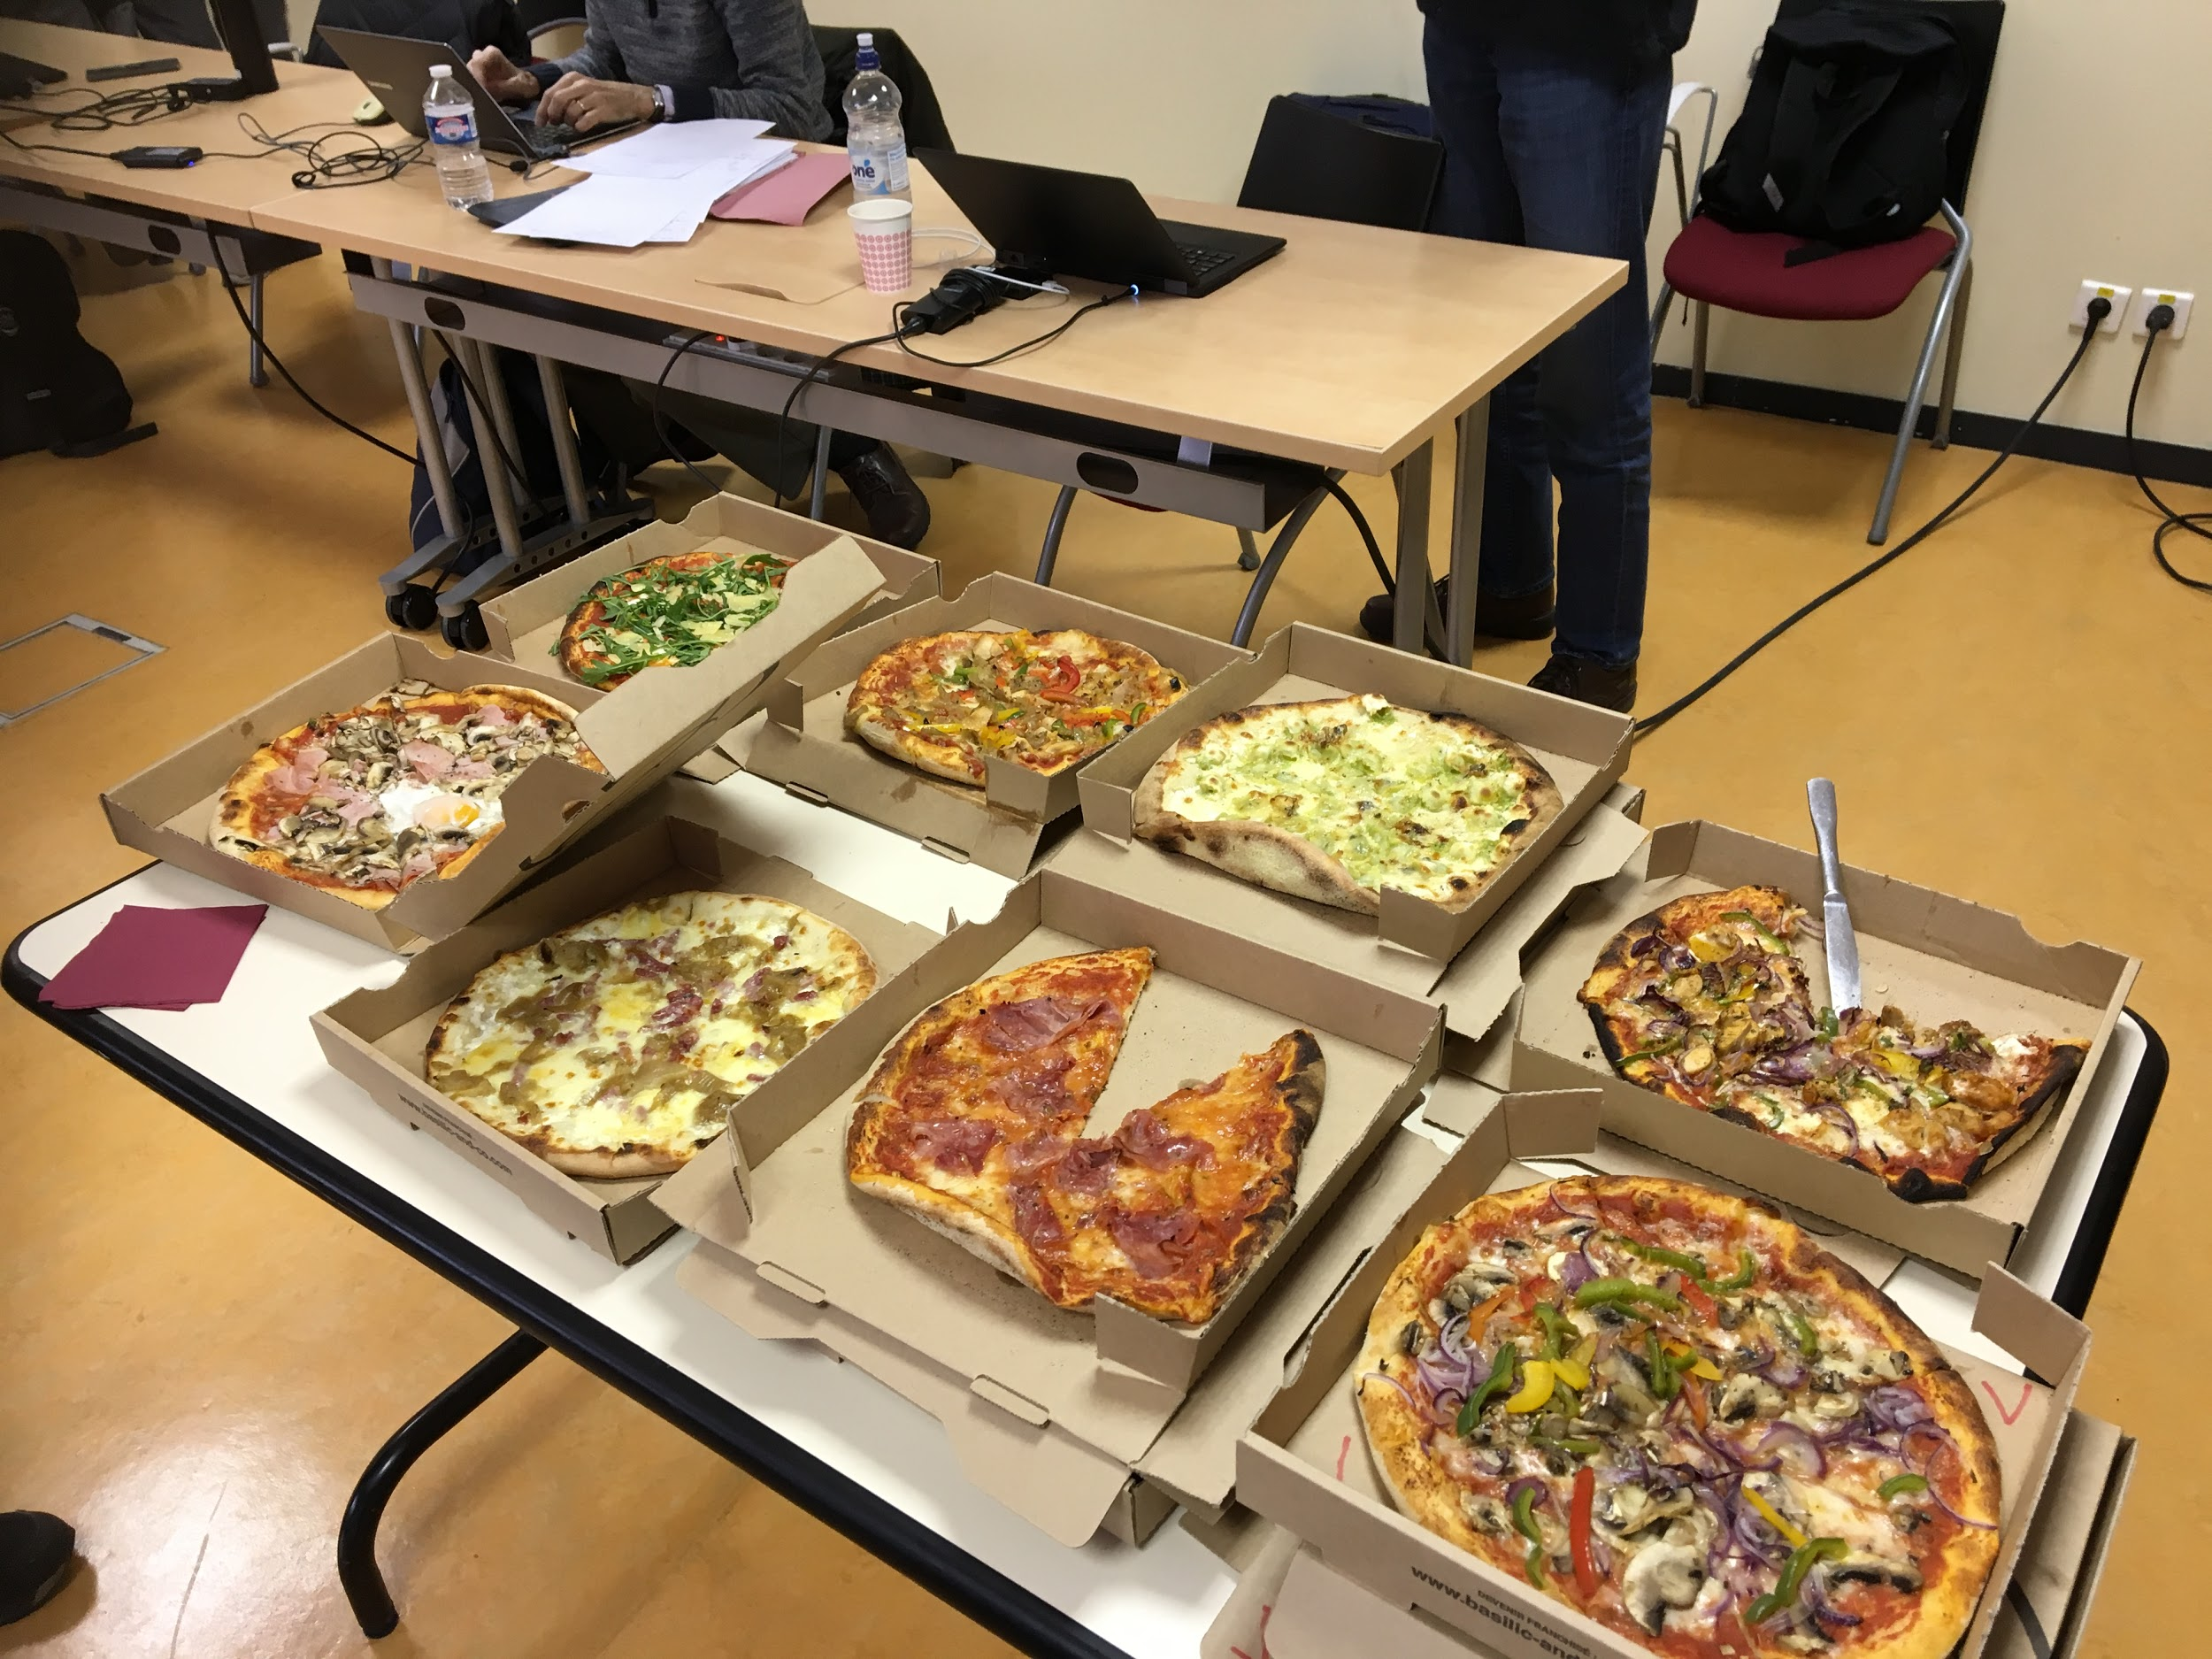
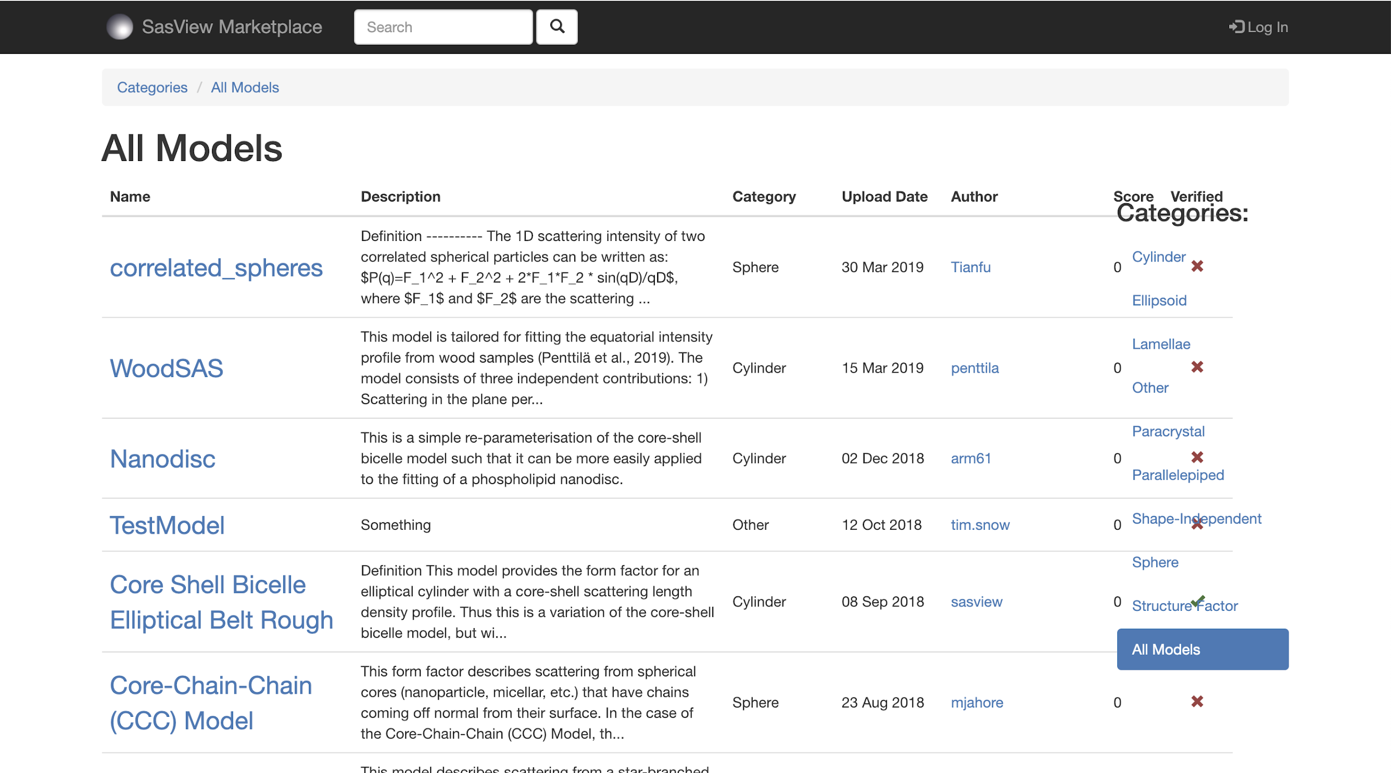
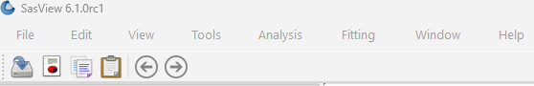
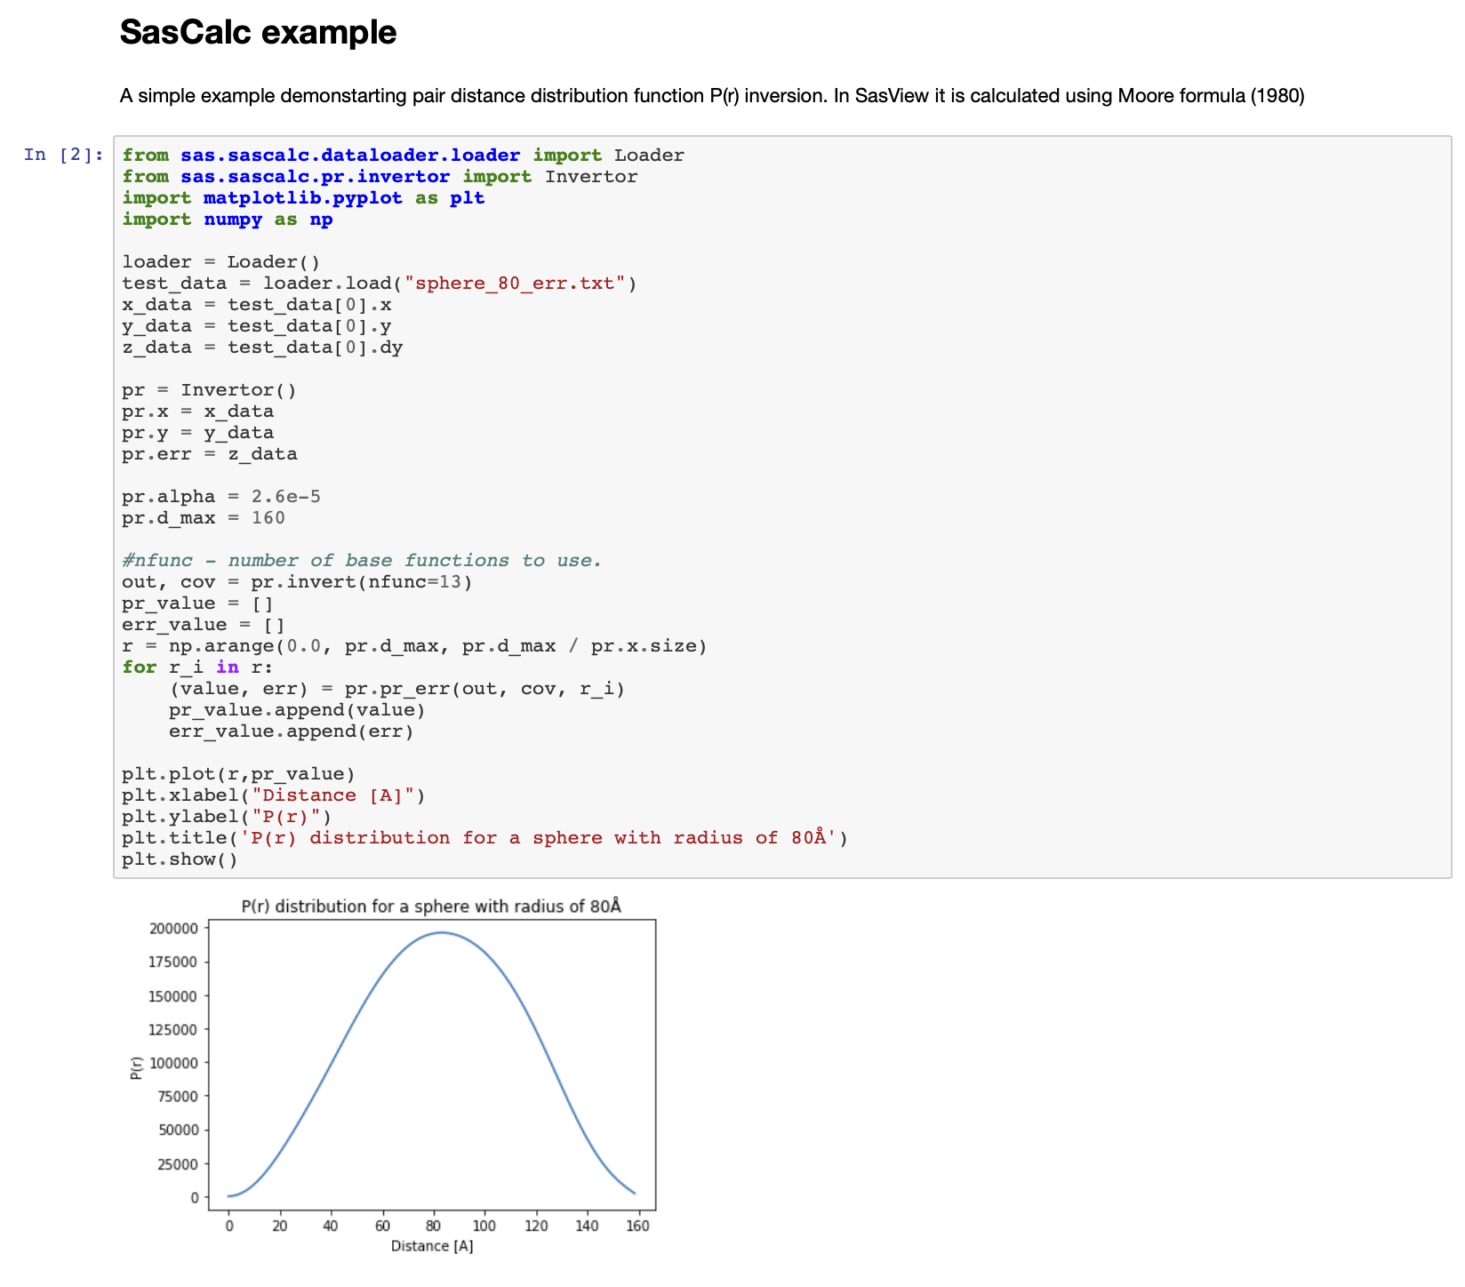

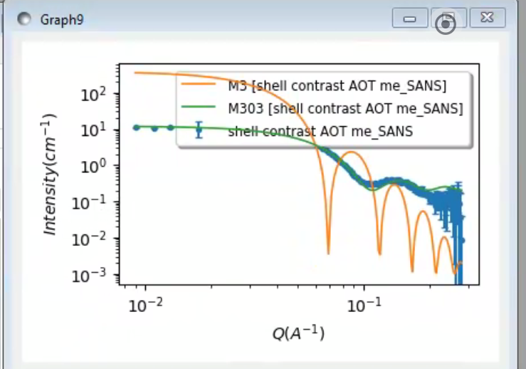
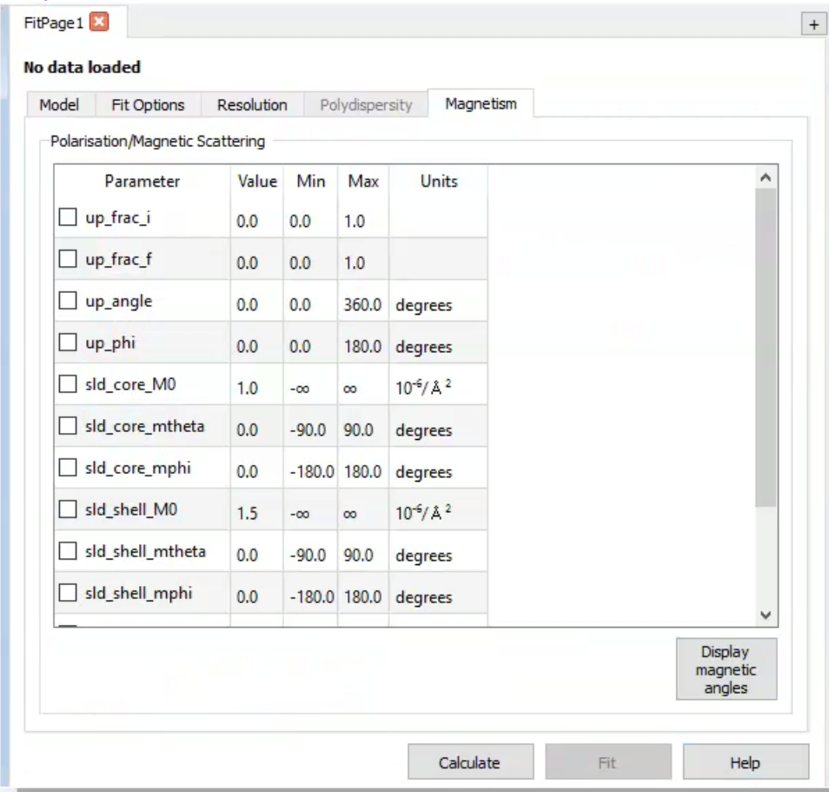
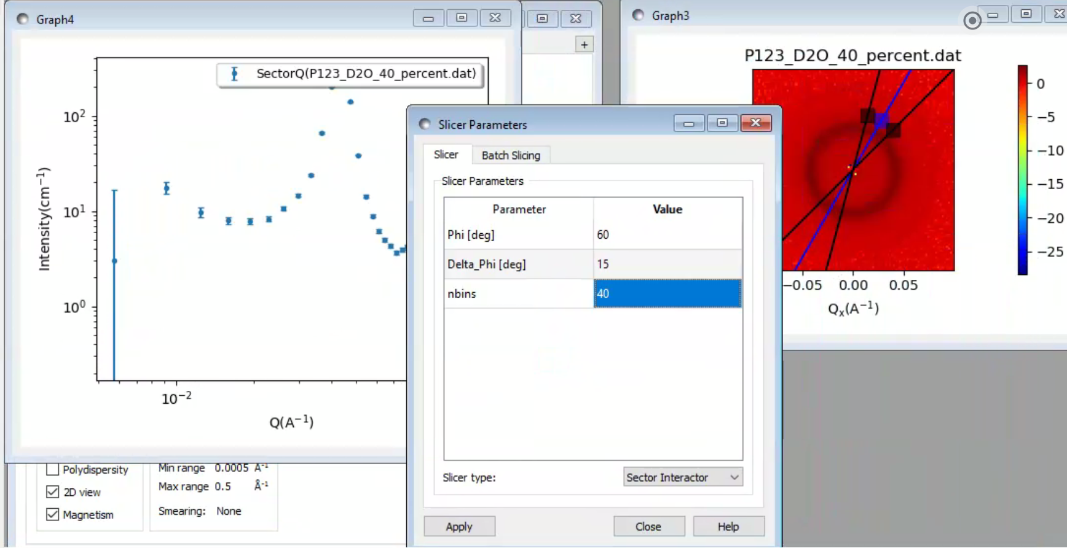
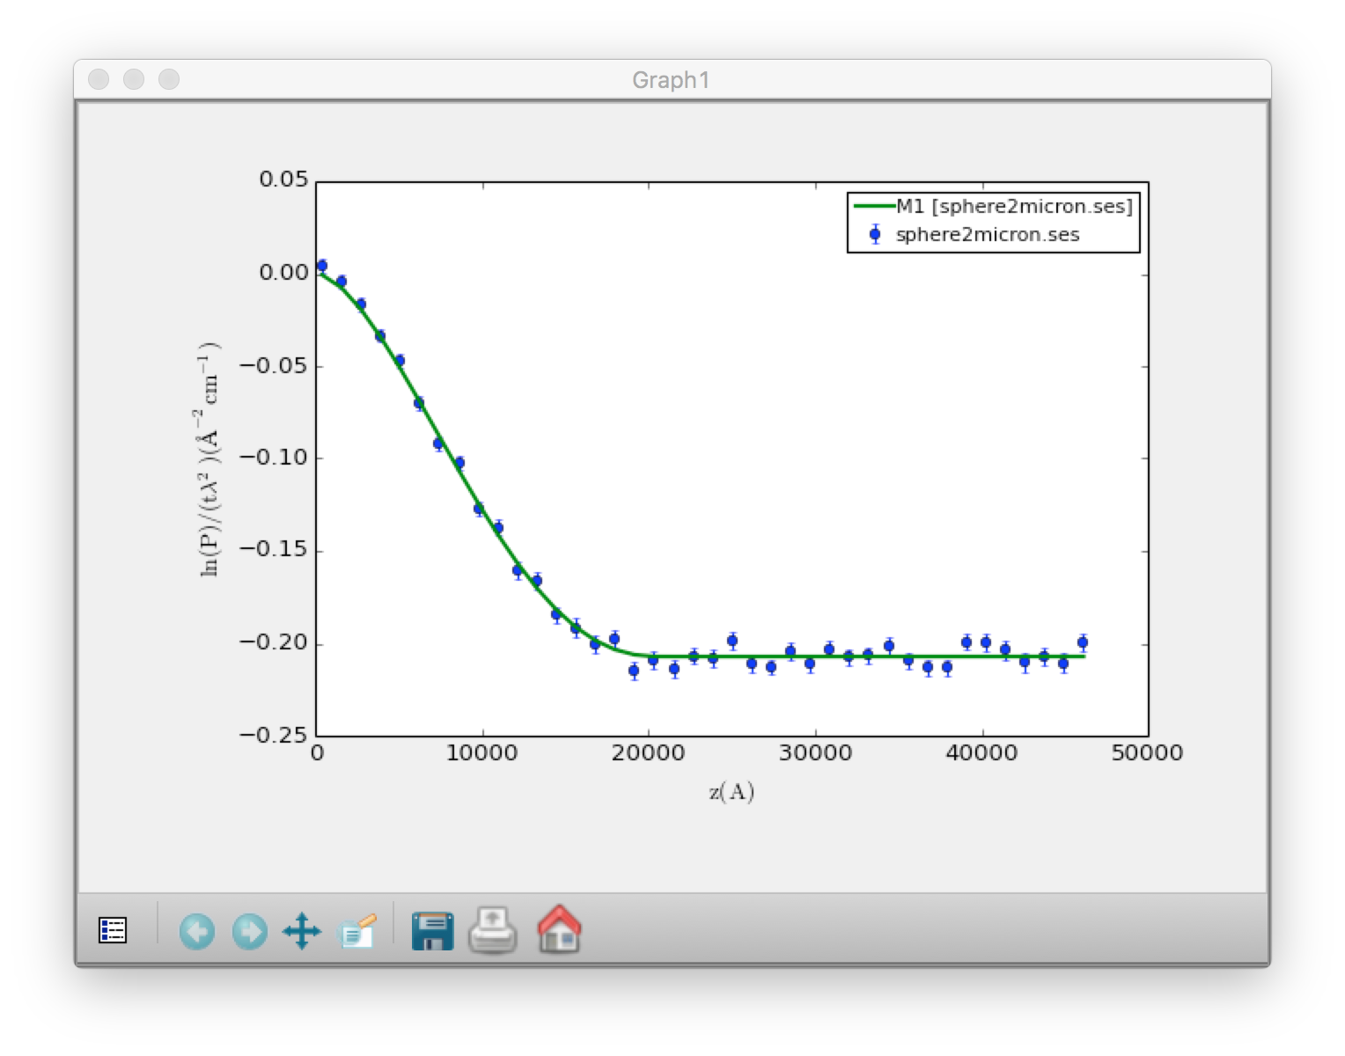
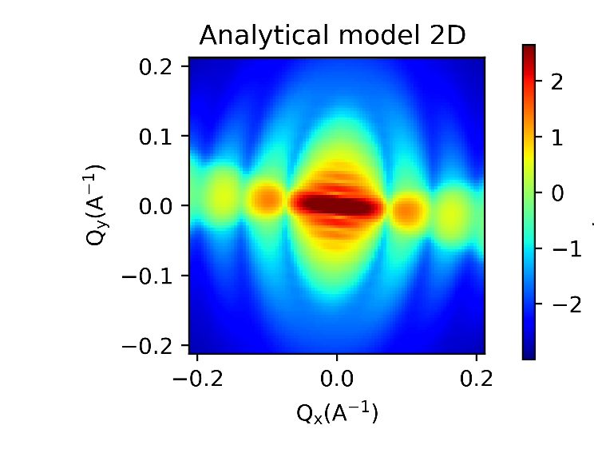
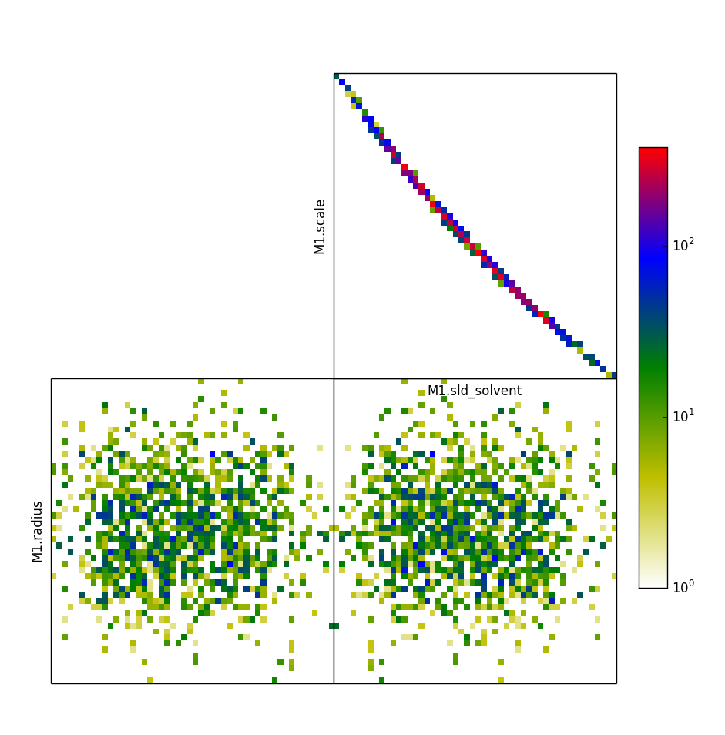
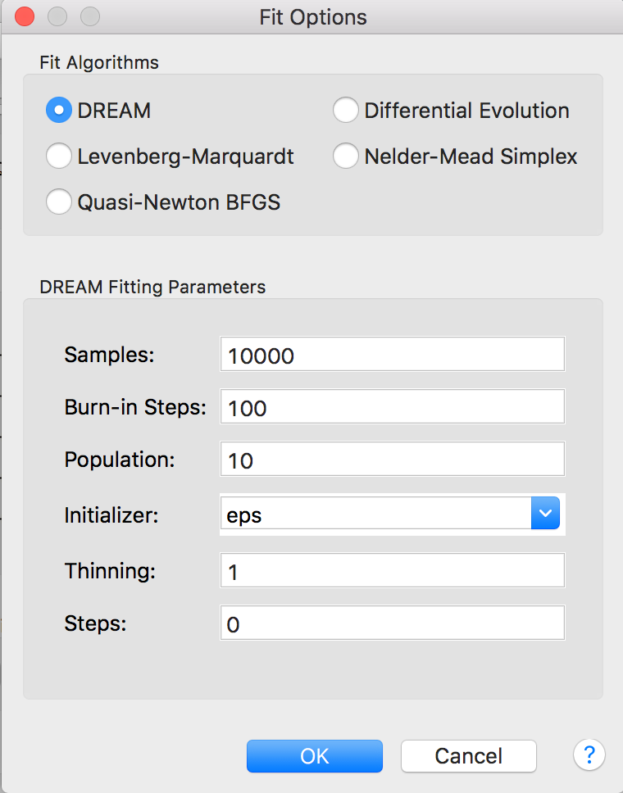
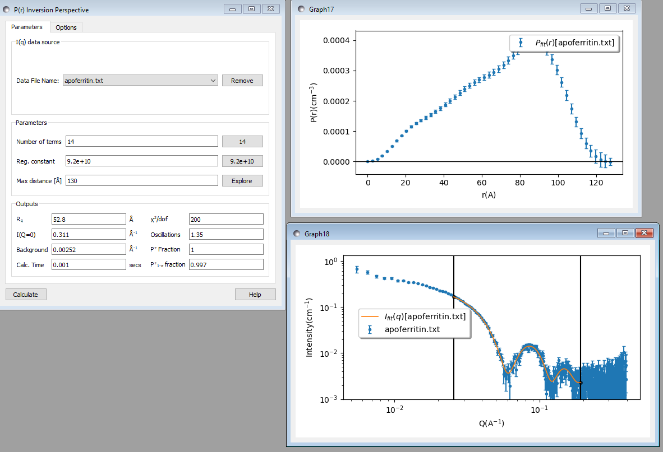
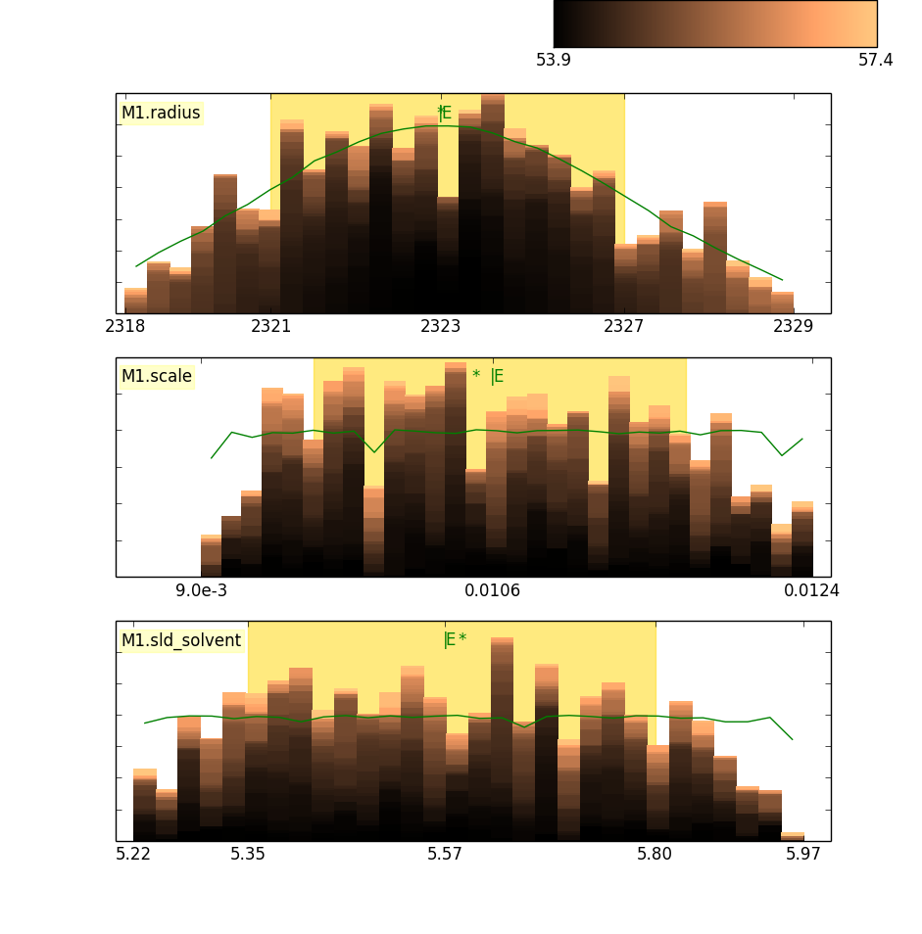
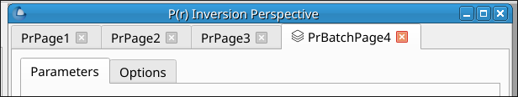
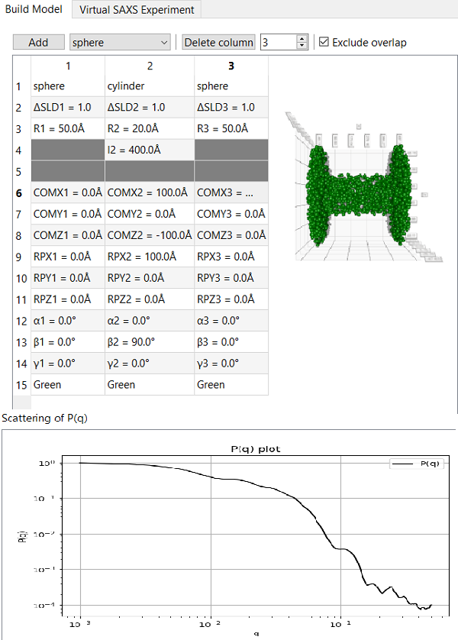
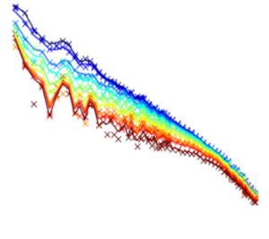
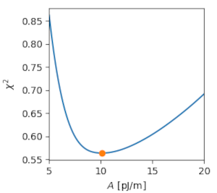
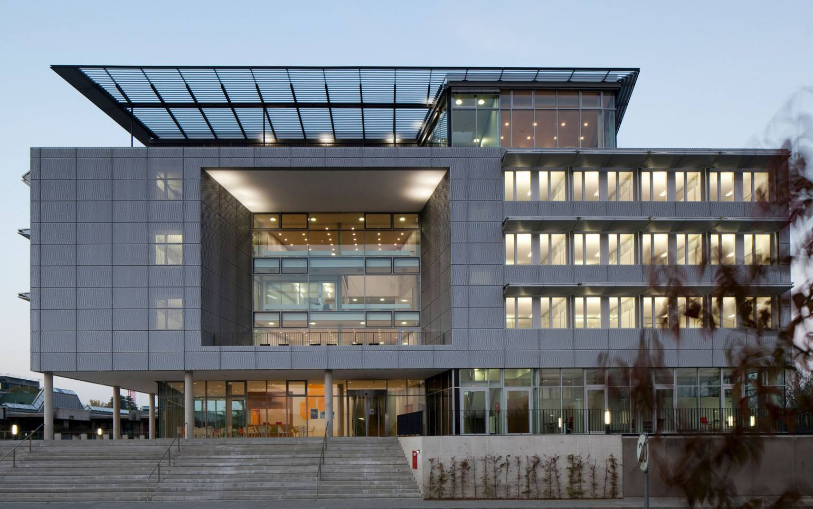
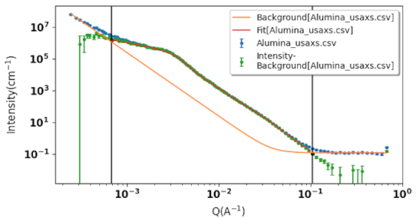
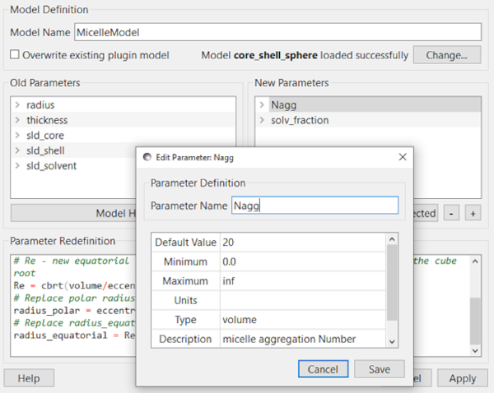
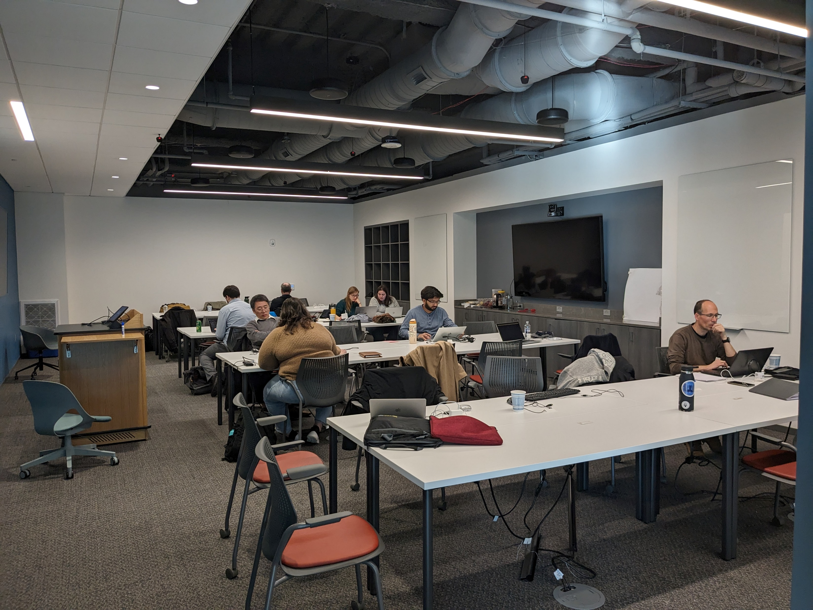
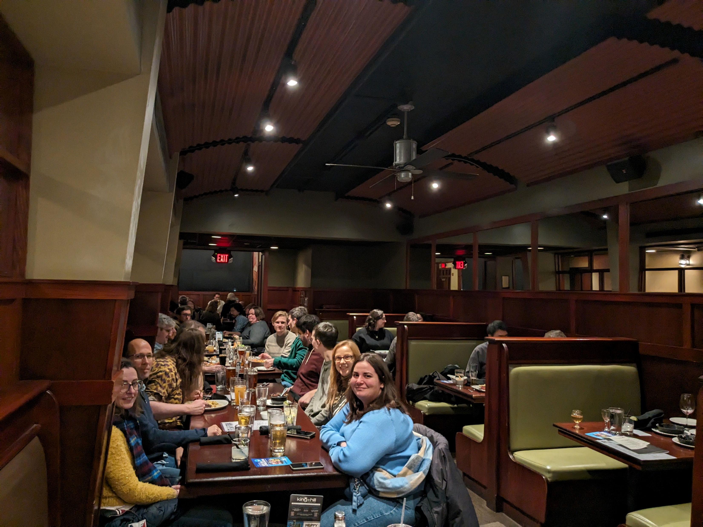
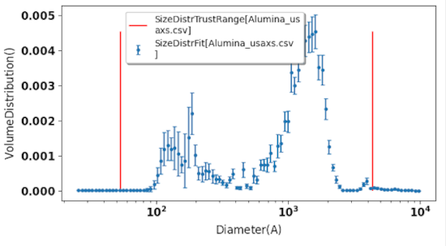
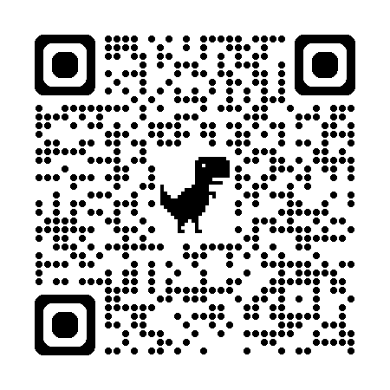
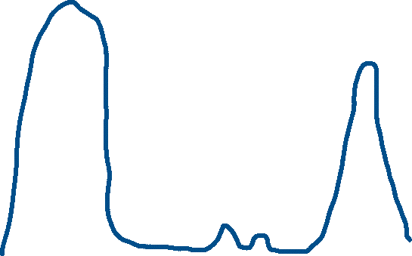
Addressing the resource problem through community:
The SasView Collaboration
The Problem Statement
Today’s analysis is beyond the skill set of most users
The unbounded problem
The SasView approach: vertical and horizontal COLLABORATIONS
Analysis Software - Who’s Job is it Anyway?
Fundamentally all the elements listed in the bar chart are relatively well-defined problems…
Scattering is an analysis tool and part of providing the tool should be the necessary software
→ the FACILITY’S JOB?
EXCEPT ...
Facilities provide foundational support through participation of data and instrument scientists
Grants and other projects provide “bold new functionality”
Community, writ large, helps provide support and functionality
New ideas tested and developed as before by individuals or larger groups (the community)
Once validated and deemed ready for the larger community these groups provide resources (their labor) to integrate while active developer community helps with training on where things go and on parts of interest to them (collaborative)
$$MONEY$$
Last priority with very limited funding left
Analysis Software is really unbounded. The needs are nearly infinite and constantly evolving.
Source Construction
Civil Construction
Reduction Sofware
Analysis is where the science is
→ the USER’S JOB?
Data Hardware
Analysis
Software??
Today’s analysis is beyond the skill set of most users
Instruments
HOWEVER --- Analysis as defined here is also uniquely universal and ripe for collaborative pooling of finite resources
Time
Or maybe …..
→ The Domain Science funding agencies?
The Valley(s) of death
A way to focus limited resources on top priorities (most useful to the science being done) in a world of infinite possibilities
A way to harness funding for bold new ideas without losing the investment in the valleys of death
A way to provide sustained maintenance and development in an uncertain funding environment (thriving through the famines)
$$MONEY$$
Facility directors’ discretion, NIH, NSF, DOE, etc.
Special funding (grants) do no fund long term maintenance and ongoing development. They fund “big new (transformative) ideas”
Time
Open, Collaborative, Community Development
Today’s analysis is beyond the skill set of most users
Website
Documentation: in-program & online
Written Tutorials
Video Tutorials (YouTube)
scattering schools/workshop
E-learning (starting)
Model Marketplace
Twitter
Bootcamps & regional workshops
Slack
help@sasview.org
users@sasview.org
developers@sasview.org
Ask not what the community is going to do for you,
ask what you can do for the community
Code is open source
publicly hosted at Github
Released under BSD 3-clause license
http://www.sasview.org
Collaboration also builds
Community
No MOU ... all are invited and welcome
Two Basic "Rules"
She who pays the piper chooses the tune
Those who bring the resources (time and effort, or funds to buy time and effort) choose what to work on.
And ...
You cannot break existing experiences ...
New dependencies vs long term maintenance (sustainability)
Code quality vs long term sustainability
Changing/degrading the current user experience for the existing user base
http://github.com/SasView
Twice monthly zoom calls
Regular ‘camps’ & ‘hackathons’
Developer's mailing list
SasView slack
Expertise sharing and helping
Small leadership team to facilitate
Code Hosting, Issue Tracking, Developer Wiki & CI on Public Github repos
Rolling 5 Year Roadmap
http://marketplace.sasview.org
(Zenodo) DOI for each release
Original put together by an ISIS Summer Student Lewis O’Driscoll
The SaView Package
Today’s analysis is beyond the skill set of most users
Today’s analysis is beyond the skill set of most users
Data Operation
SLD calculator
Density/Volume calculator
Kiessig Thickness Calculator
Q Resolution Estimator
Orientation Viewer​
Tools
Slit Size Calculator
Python Shell/Editor​
Image Viewer​
File Converter​
Generic Scattering Calculator​
MuMag
Shape2SAS
HISTORY/STATUS
Perspectives on the data
Jupyter Notebooks
and Command Line
2006; originates in NSF DANSE project
2013; transitions into a community project
2016; Sine2020 project funded
2022; Essentially a “volunteer army”
--------------------
80+ contributors from 15 organizations, including 6 Universities… and growing (~10-15 active at any one time)
1 to 2 releases/year (6.1 JUST RELEASED)
Documentation/tutorial projects ongoing
Usage? Seems to be "everywhere?"
Correlation Function
Size Distribution
Invariant
Pr Inversion
Fitting
Data Management
Magnetic Parameters
Most all 1D data types supported. Standard 2D also
Some image and odd data supported through converters
All data output in NXcanSAS format.
Calculated curves associated with data (PQ, SQ, desmeared model, etc) accessible individually.
Project saving capabilities (currently a bit fragile)
SOME CHALLENGES
1D and 2D analysis
Choice of Optimizers
The price of success: Building community resources is hard (Help needed!)
Professional effort suggest project is funded, even well funded.
Hard to persuade non-coder experts of the huge value of their contributions
Current size of code base is a barrier to new volunteer coders
Hard to keep up with increasing security issues given resources
SESANS analysis
P(R) Perspective
Slicers
NEW in 6.1.0
Today’s analysis is beyond the skill set of most users
P(R) inversion is now tabbed, ready for batch runs
(ISIS)
A version of the MuMag tool
(University of Luxembourg/ISIS)
CURRENT PROJECTS
CONTINBUTOR CAMP
(A Hackathon Week!)
A version of the Shape2SAS tool
(Copenhagen University/NIST)
Ongoing major refactoring:
Data loading, handling and manipulation infrastructure
Plotting infrastructure
WHEN: November 11-17, 2025 (7 days of fun!)
WHERE: Garching, Germany at TUM
Size Distribution Analysis
(ORNL, Princeton, NIST)
New Reparameterization model Editor and improved Model Editor
(NIST)
Major current effort:
Magnetic and polarized beam SANS and anisotropic data analysis
COME JOIN
THE PARTY!!

